Slide 1
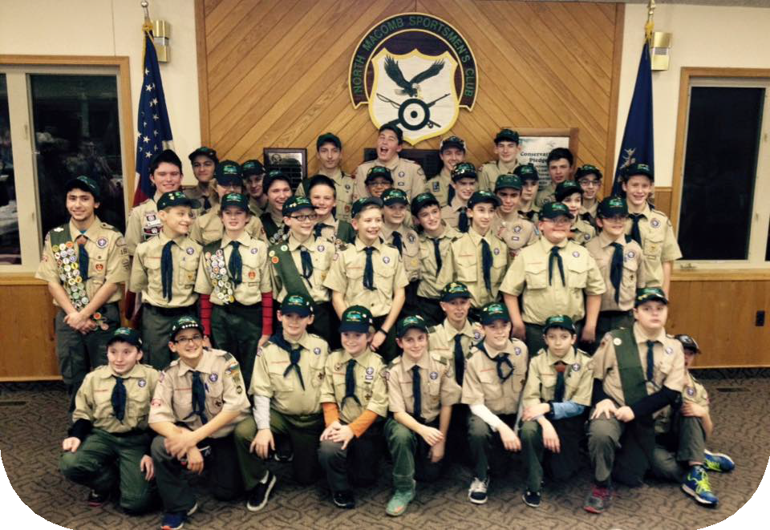





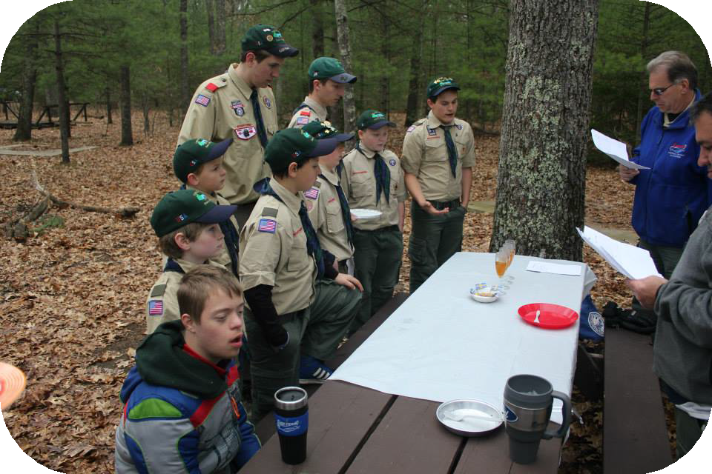

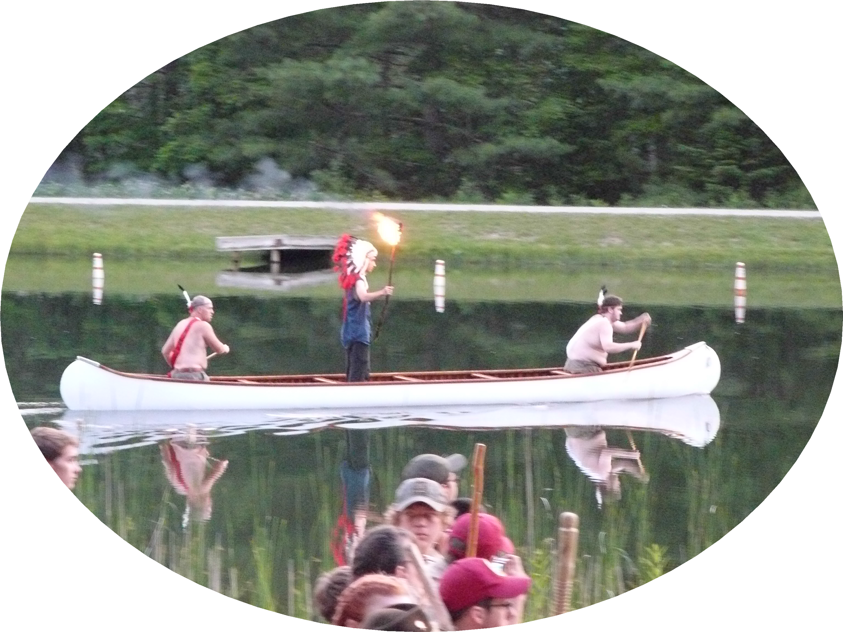

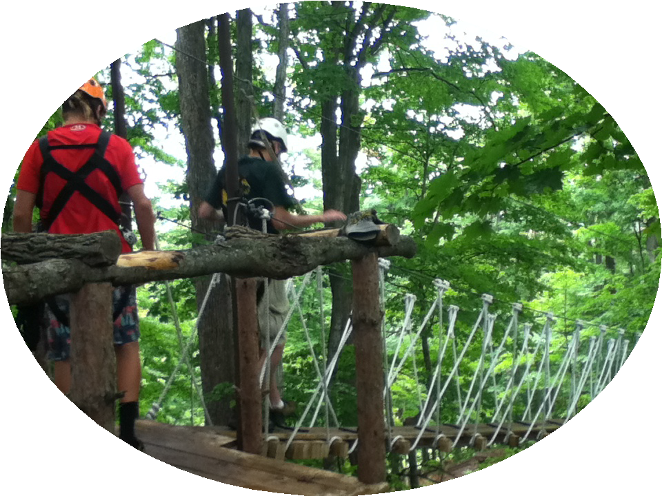


Monday Meetings 7pm
Troop 156 Webelos Troop Visit
…Your Path to Great Adventure
9/23 –Legends Camporee, Stony Creek
10/14 – Biking Campout , Ohio
11/4 - Thanksgiving Cookout D-BAR-A
12/10 - Lock in.
1/20 Winter Sports Muskegon/Tree Tops
2/10– Cole Winter Camping/Shelter
3/24 - Scout Skills @ D-Bar-A
4/21 - Cooking Competition @Camp Teetonkah Jackson Mi
5/12 - Grey Fox Naval Vessel
6/18 - Summer Camp Beaumont SR, OH
7/? - Whitewater Rafting West Virginia
8/? - Upper Peninsula Adventure
9/10 - TBD
Meetings held at Morgran Elem. 53800 Mound Rd Shelby Twp
Contact
Scott Boice
boice19@comcast.net
Troop 156 originated in 1967
33 active Boy Scouts in our boy-led troop
149 boys have reached Eagle rank
Activities include backpacking, canoeing, wilderness survival, and high adventure
Many opportunities for community service
www.troop156bsa.com

Slide 2
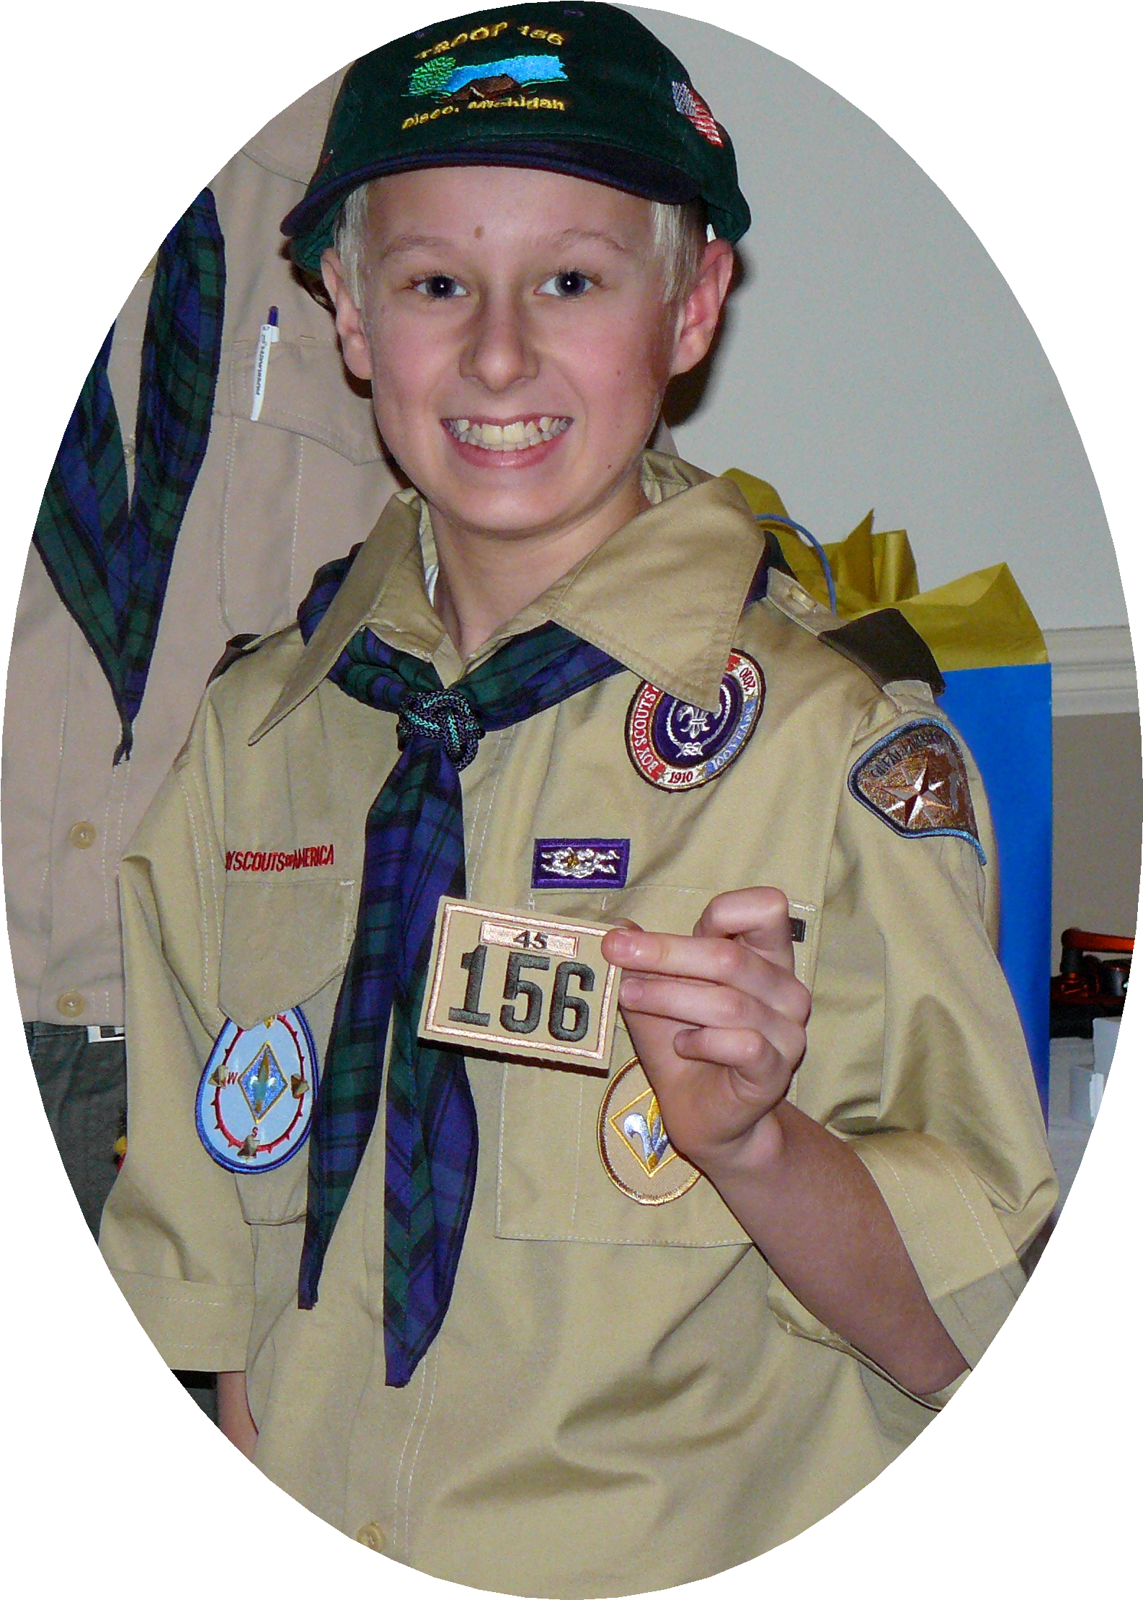



Bring this sheet with you to start working on requirements so you have a head start once you crossover into Troop 156
Our troop will be uses the Edge Method: Explain, Demonstrate, Guide, and Enable to help teach the Webelos and Scouts.
Scout Requirements (8/1/22)
1a. Repeat from memory the Scout Oath, Scout Law, Scout motto, and Scout slogan. In your own words, explain their meaning.
1b Explain what Scout spirit is. Describe ways you have shown Scout spirit by practicing the Scout Oath, Scout Law, Scout motto, & Scout slogan.
1c Demonstrate the Boy Scout sign, salute, and handshake. Explain when they should be used.
1d Describe the First Class Scout badge and tell what each part stands for. Explain the significance of the First Class Scout badge.
1e Repeat from memory the Outdoor Code. List the seven principles of Leave No Trace. Explain the difference between the two.
1f Repeat from memory the Pledge of Allegiance. In your own words, explain its meaning.
2a Describe how the Scouts in the troop provide its leadership
2b Describe the four steps of Boy Scout advancement.
2c Describe the Boy Scout ranks and how they are earned.
2d Describe what merit badges are and how they are earned.
3a Explain the patrol method. Describe the types of patrols that are used in your troop.
3b Become familiar with your patrol name, emblem, flag, and yell. Explain how these items create patrol spirit.
4a Show how to tie a square knot, two half-hitches, and a taut-line hitch. Explain how each knot is used.
4b Show the proper care of a rope by learning how to whip and fuse the ends of different kinds of rope.
5 Tell what you need to know about using a pocketknife safely and responsibly.
6 With parent/guardian, complete exercises in How to Protect Your Children From Child Abuse: A Parent’s Guide and earn the Cyber Chip Award. Or view the Personal Safety Awareness videos (with your Parent’s or Guardian’s permission)
7 Since joining the troop and while working on Scout rank, participate in a Scoutmaster conference.

